Slide 1

Kashif Ross, MS
Jackie Kokx, MS
Rosie Martinez, ScD, MPH
Rylan Larsen, PhD
Megan Bultema, PhD
Olive4Equity amplifies the voices of Black mothers. We do this by providing remote and integrated blood pressure monitoring in the immediate postpartum period.
Ideas presented here are not an official position of Olive

Slide 2
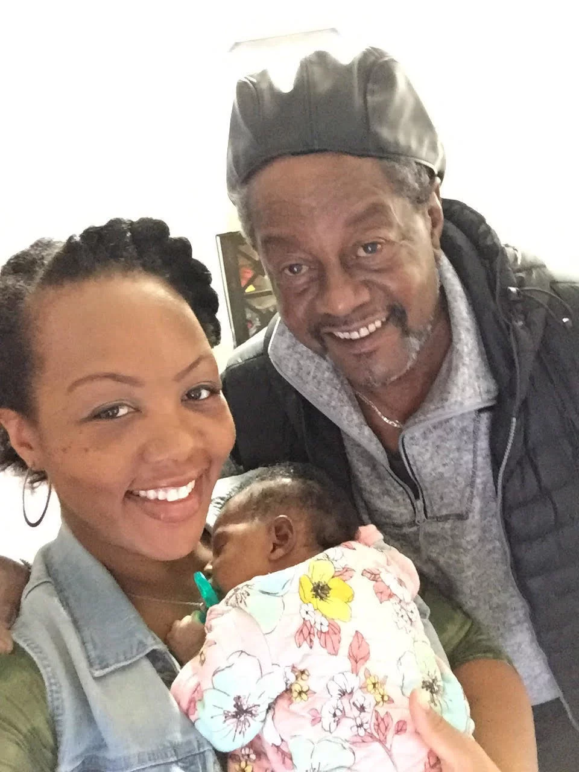
Olive4Equity - Amplify the voices of Black mothers
The problem
Shalon Irving was a 36-yr-old epidemiologist at the CDC, with a dual-subject Ph.D., a gold-plated insurance, and a rock-solid support system died 3 weeks after giving birth due to high blood pressure complications in Georgia.
Notes:
She did go to her provider - her concerns turned away
Having the track of objective data
https://www.npr.org/2017/12/07/568948782/black-mothers-keep-dying-after-giving-birth-shalon-irvings-story-explains-why

Slide 3
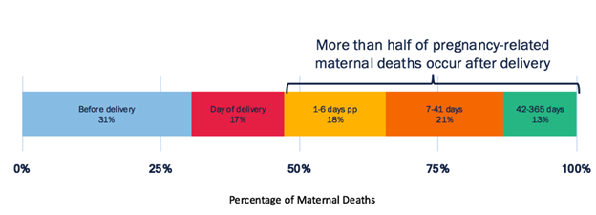
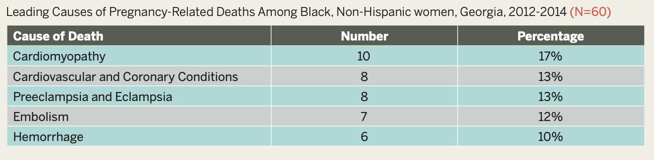
Olive4Equity - Amplify the voices of Black mothers
The problem
Over 50% of pregnancy related deaths occur postpartum
Cardiovascular-related diseases are the leading causes of death for Black mothers in Georgia
Hypertensive disorders of pregnancy, which includes the post-partum period, can lead to immediate and long-term complications
Studies show that providing postpartum at home blood pressure monitoring can reduce time to treatment and frequency of readmission (last slide citations)
Creanga AA, Syverson C, Seed K, Callaghan WM. Pregnancy-related mortality in the United States, 2011-2013. Obstet Gynecol. 2017;130(2):366-73.
https://dph.georgia.gov/sites/dph.georgia.gov/files/related_files/site_page/Georgia%20Maternal%20Mortality%20Report%202014.pdf
https://www.ncbi.nlm.nih.gov/pmc/articles/PMC7289450/
Notes:
Post as an action = given all of this, we belive we can reduce the the burden of these cardiovascular related diseases on maternal mortality through blood pressure monitoring
Georgia is the worst place for Black mothers to give birth in the United States.
They have 4x more likely to die than white mothers
Their voices are more likely to be ignored when expressing pain or requesting additional care
The second leading cause of maternal mortality is high blood pressure. 80% of maternal deaths can be avoided with:
Access to care
Access to information
Timely diagnosis
Right and timely treatment
In the first week postpartum, severe bleeding, high blood pressure, and infection are the most common contributors to maternal deaths, while cardiomyopathy is the leading cause of late deaths.6
https://www.npr.org/2017/12/07/568948782/black-mothers-keep-dying-after-giving-birth-shalon-irvings-story-explains-why
Hoppe, K. K., Thomas, N., Fedenia, K., Zernick, M., Zella, J. B., Shah, D. M., … Johnson, H. (2019). 451: A non-randomized controlled study: Telehealth with remote patient monitoring vs standard care for postpartum hypertension. American Journal of Obstetrics and Gynecology, 220(1). doi: 10.1016/j.ajog.2018.11.472
Hoppe, K. K., Williams, M., Thomas, N., Zella, J. B., Drewry, A., Kim, K., … Johnson, H. M. (2019). Telehealth with remote blood pressure monitoring for postpartum hypertension: A prospective single-cohort feasibility study. Pregnancy Hypertension, 15, 171–176. doi: 10.1016/j.preghy.2018.12.007
Optimizing postpartum care. ACOG Committee Opinion No. 736. American College of Obstetricians and Gynecologists. Obstet Gynecol 2018;131:e140–50.
Hauspurg A, Lemon LS, Quinn BA, Binstock A, Larkin J, Beigi RH, Watson AR, Simhan HN. A Postpartum Remote Hypertension Monitoring Protocol Implemented at the Hospital Level. Obstet Gynecol. 2019 Oct;134(4):685-691. doi: 10.1097/AOG.0000000000003479. PMID: 31503166; PMCID: PMC7289450.

Slide 4
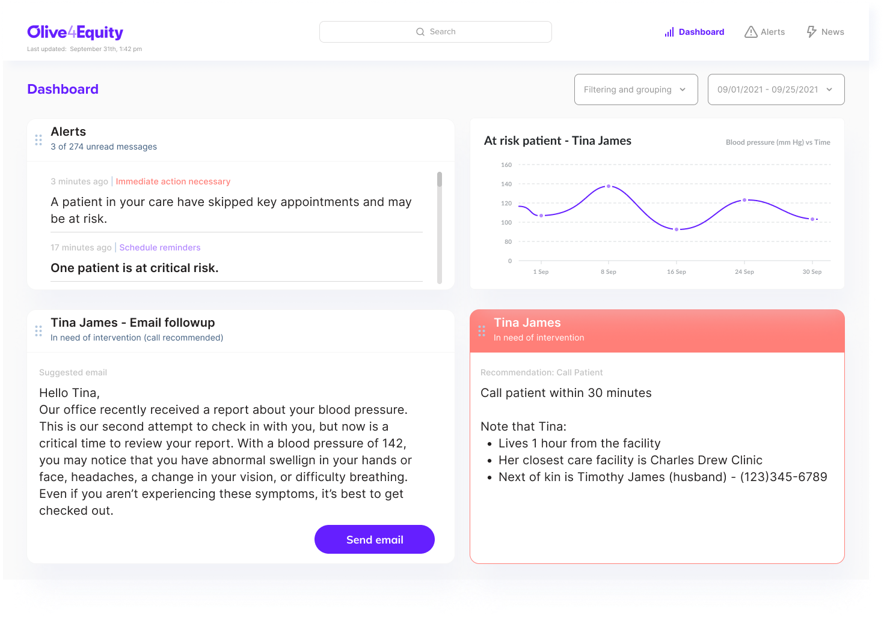
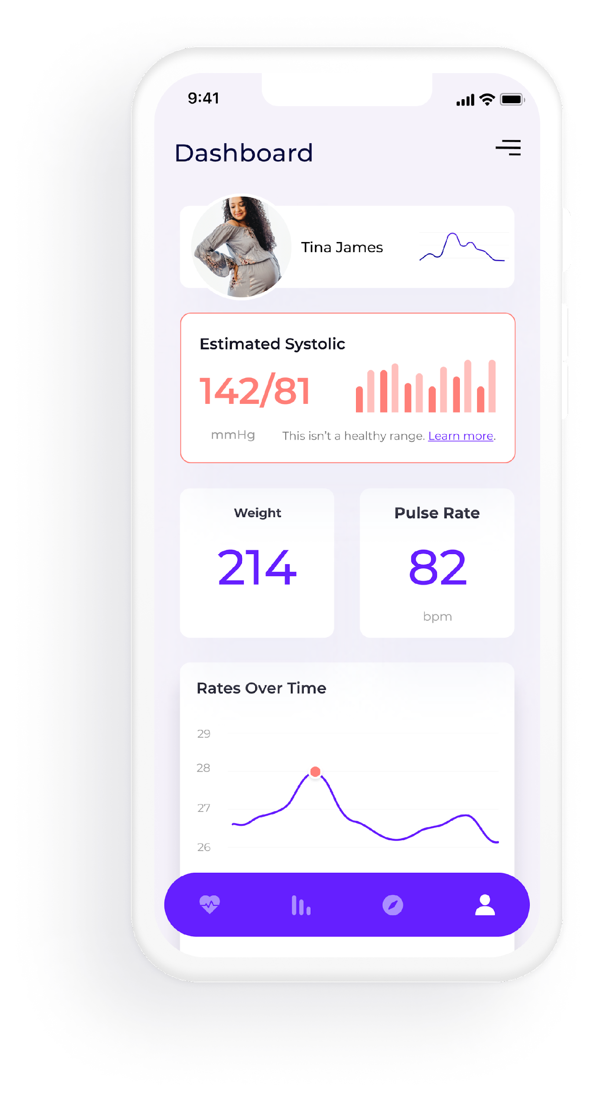
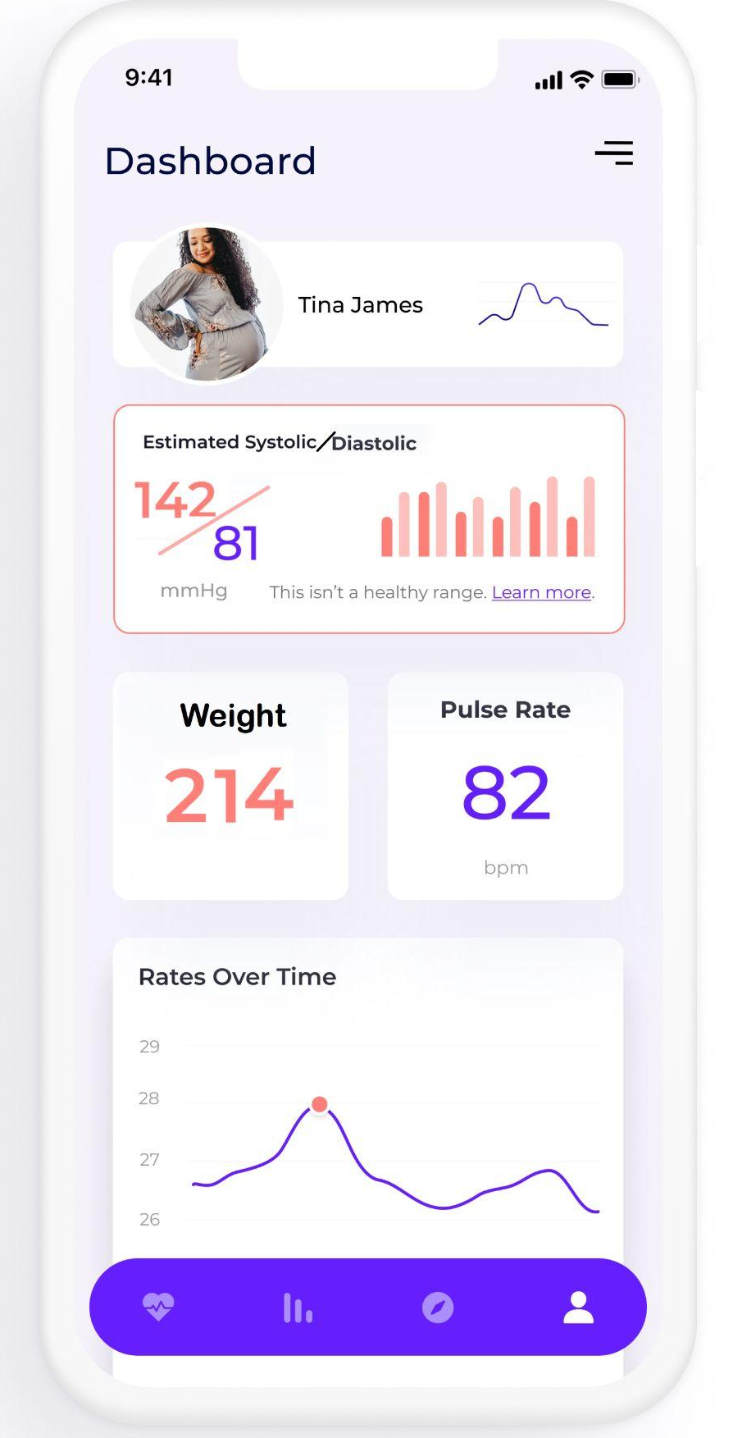
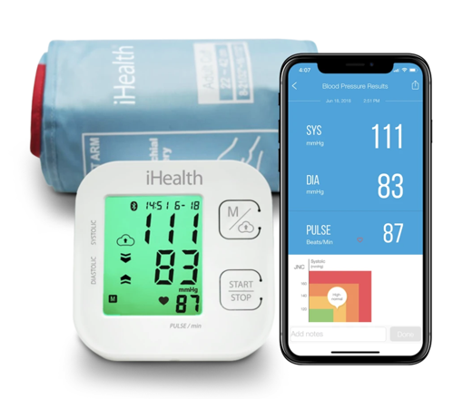
Olive4Equity - Amplify the voices of Black mothers
The Solution: Daily home blood pressure monitoring through mobile devices for early detection of hypertensive signs in Black postpartum mothers integration and alert system for providers.
Notes:
Our solution is to provide bluetooth enabled blood pressure monitors to mothers during discharge after delivery. Discharge nurses will offer training and assistance with the initial app setup and calibration. Women will be prompted to take their blood pressure daily in the postpartum period up to 6 weeks and their blood pressure readings will be integrated back to the provider systems. On the provider side, the data is tracked and used to initiate an alert to take action for outreach. Automated emails will be sent on their behalf to schedule follow ups or in the acute cases phone calls directly to the patient. Providers are given context for the outreach with a simplified UI that prevents providers from needing to train their staff. These alerts are also meant to avoid adding to the alarm fatigue that hospitals endure on a day to day basis. Our goal is to help providers recognize the issue with digestible data, giving admin and physicians the data they need to track and recognize this issue.

Slide 5
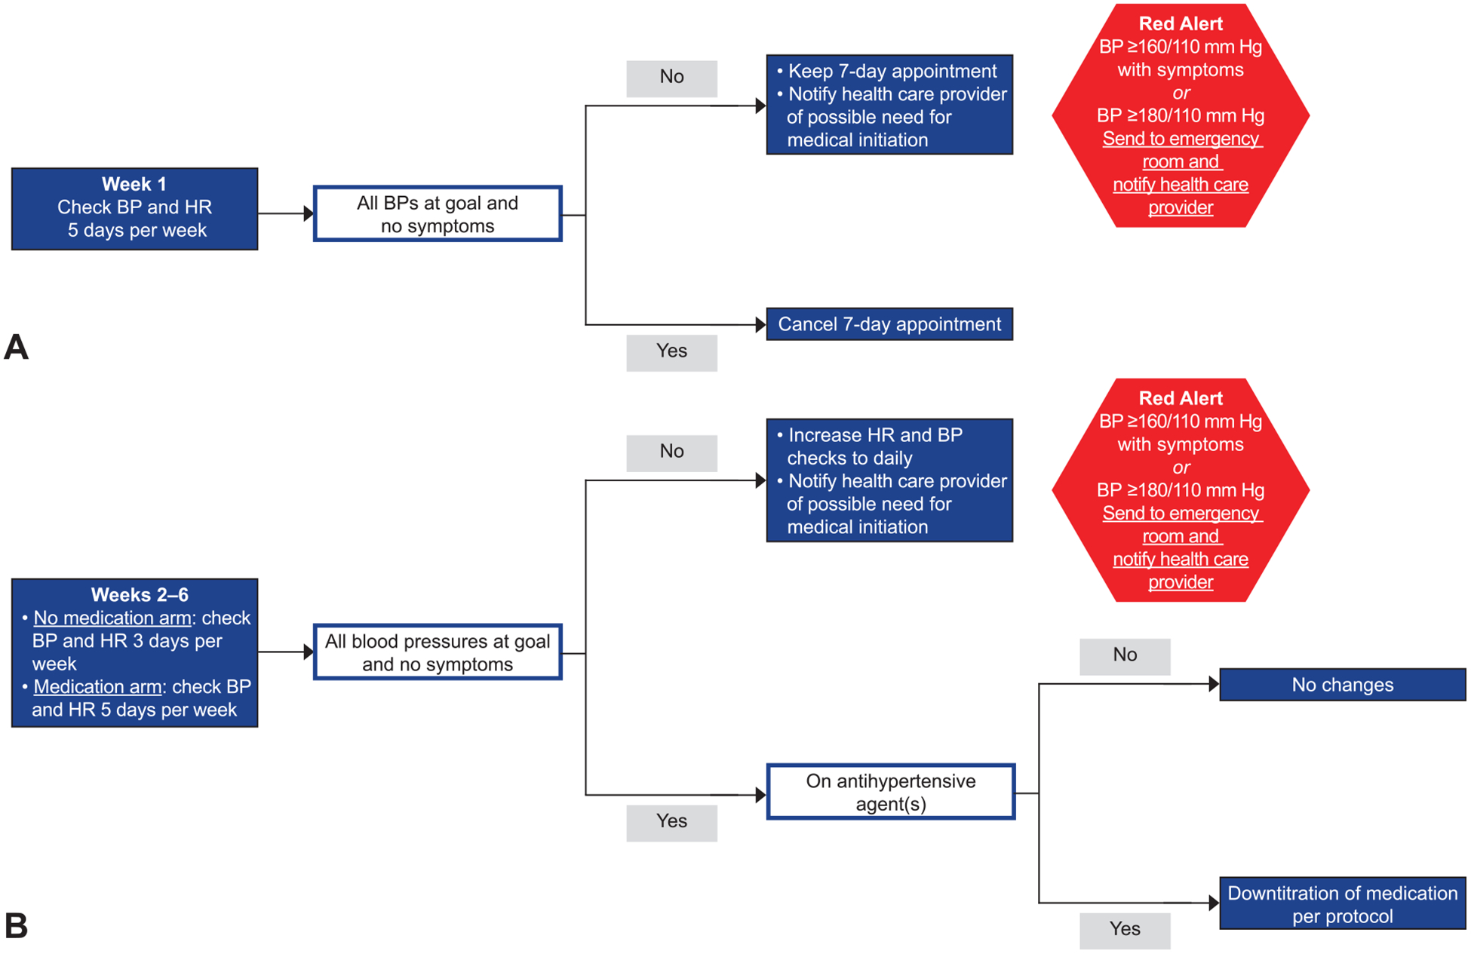
Olive4Equity - Amplify the voices of Black mothers
Pilot Study
https://pubmed.ncbi.nlm.nih.gov/31503166/#affiliation-1
Notes:
Now we know that the idea of a home blood pressure monitoring system isn’t a new approach. Our system, in particular, is expanding upon what was a successful pilot program start in Pittsburgh and bringing that to Georgia and in particular Black mothers in GA. The initial study showed high compliance, high retention, and high patient satisfaction.
We also envision adding an extra layer in automating the data integration that is coming from the home blood pressure monitor to a providers electronic record system at the hospital. This automation gets eyes on a patient sooner and more often during her postpartum weeks.
This tracking of the data also decreases the time it takes to get to a decision tree like this one and allows for action to be taken. Action could include the adjustment of medications or appointments while the patient is still at home instead of having to come in multiple times postpartum into the clinic. This technology more importantly support women by giving them objective data to back up their voices when talking with their provider about concerns they may have and how they are feeling in these postpartum weeks.
This could have been especially helpful for a case like Shalon Irving’s, where she did bring up her concerns to her provider, but having multiple data points of high blood pressure readings could have amplified her concerns while giving the provider enough readings to support an earlier diagnosis.

Slide 6
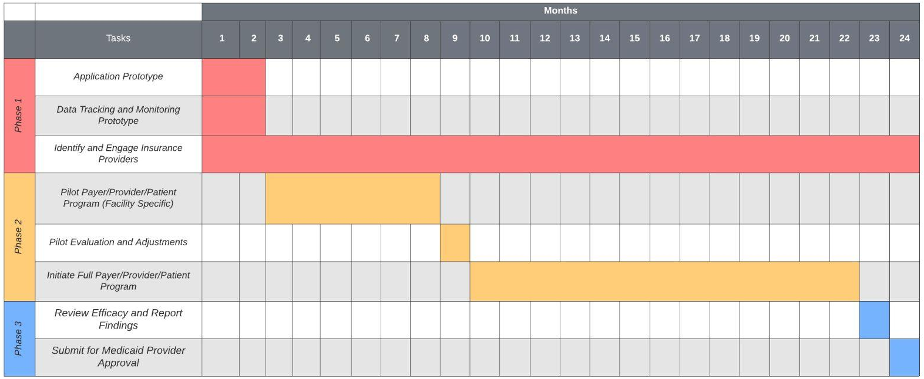
Olive4Equity - Amplify the voices of Black mothers
Implementation
Notes:
We know that this is an issue that impacts mothers across socioeconomic groups. We believe that there is a large financial incentive for payers to support this initiative to reduce acute returns. We want to leverage this interest to fund a two stage pilot project in Georgia. THis pilot project will be use to judge efficacy and report on findings. We can use this information to drive adoption across medicaid providers.

Slide 7
Olive4Equity - Amplify the voices of Black mothers
Benefits & Advantages
Black Mothers
Providers
Access care from home & reduced travel time to appointments
Relevant information on risks of cardiovascular complications
Black mother empowerment
Record of objective data to advocate for care
Reduced risk of exposure to Covid-19
More eyes on the patient
View of blood pressure during daily activities
More blood pressure readings to support diagnosis
Curated content to reduce alarm fatigue
Relevant context to facilitate care
01
02
Intersection
Identify and treat cardiovascular complications before disastrous outcomes
03
Payer/Insurance
Funded solution to reduce maternal mortality in Georgia due to cardiovascular complications in the postpartum period
Reduce occurence of costly readmissions

Slide 8

Olive4Equity - Amplify the voices of Black mothers
Closing
We believe that objective data can amplify Black mother’s voices and save lives like Shalon Irving’s.
Integrating mobile devices with provider systems can provide access to treatment for communities in a care desert.
Daily home blood pressure monitoring in the postpartum period can reduce maternal mortality of Black mothers in the state of Georgia.

Slide 9
Olive4Equity - Amplify the voices of Black mothers
Solution: Addressing questions
Will this solution be accessible?
2018 report about Medicaid and digital health: "Our survey finds that adult Medicaid beneficiaries own smartphones (86 percent) and tablets (69 percent) at the same rates as the general adult US population (86 percent and 72 percent, respectively)"
Include an ‘offline’ mode where the mothers have a paper log to take home and in info sheet on when to call their provider.
Is my privacy protected?
Create a stable workflow that ensures all data is captured and secured correctly in a HIPAA compliant manner. This ensures the reliability of data and keeps the information secure from the source to the storage.
Make it optional to share the data with your provider or not. Patient facing app will still have the ability to track and inform mothers of cardiovascular risk.
https://cookcountyhealth.org/wp-content/uploads/6.-SP-HIS-article-2-12-21-18.pdf

Slide 10
Olive4Equity - Amplify the voices of Black mothers
Value of Olive4Equity
Previous studies supporting use of home blood pressure monitoring in postpartum period.
Hoppe, K. K., Thomas, N., Fedenia, K., Zernick, M., Zella, J. B., Shah, D. M., … Johnson, H. (2019). 451: A non-randomized controlled study: Telehealth with remote patient monitoring vs standard care for postpartum hypertension. American Journal of Obstetrics and Gynecology, 220(1). doi: 10.1016/j.ajog.2018.11.472
Hoppe, K. K., Williams, M., Thomas, N., Zella, J. B., Drewry, A., Kim, K., … Johnson, H. M. (2019). Telehealth with remote blood pressure monitoring for postpartum hypertension: A prospective single-cohort feasibility study. Pregnancy Hypertension, 15, 171–176. doi: 10.1016/j.preghy.2018.12.007
Optimizing postpartum care. ACOG Committee Opinion No. 736. American College of Obstetricians and Gynecologists. Obstet Gynecol 2018;131:e140–50.
Hauspurg A, Lemon LS, Quinn BA, Binstock A, Larkin J, Beigi RH, Watson AR, Simhan HN. A Postpartum Remote Hypertension Monitoring Protocol Implemented at the Hospital Level. Obstet Gynecol. 2019 Oct;134(4):685-691. doi: 10.1097/AOG.0000000000003479. PMID: 31503166; PMCID: PMC7289450.
Benefits | Olive4Equity | The Cuff Project The Preeclampsia Foundation
Validated BP Device | Yes | Yes
BP Data Sent to Provider | Automatically | Manually
Educational Information Provided | Yes | Yes
Designated Medical Support Call | Yes | No
Funding | Insurance Providers | The Preeclampsia Foundation
Published Pilot Program | Yes | No

Slide 11
References:
Hoppe, K. K., Thomas, N., Fedenia, K., Zernick, M., Zella, J. B., Shah, D. M., … Johnson, H. (2019). 451: A non-randomized controlled study: Telehealth with remote patient monitoring vs standard care for postpartum hypertension. American Journal of Obstetrics and Gynecology, 220(1). doi: 10.1016/j.ajog.2018.11.472
Hoppe, K. K., Williams, M., Thomas, N., Zella, J. B., Drewry, A., Kim, K., … Johnson, H. M. (2019). Telehealth with remote blood pressure monitoring for postpartum hypertension: A prospective single-cohort feasibility study. Pregnancy Hypertension, 15, 171–176. doi: 10.1016/j.preghy.2018.12.007
Optimizing postpartum care. ACOG Committee Opinion No. 736. American College of Obstetricians and Gynecologists. Obstet Gynecol 2018;131:e140–50.
Hauspurg A, Lemon LS, Quinn BA, Binstock A, Larkin J, Beigi RH, Watson AR, Simhan HN. A Postpartum Remote Hypertension Monitoring Protocol Implemented at the Hospital Level. Obstet Gynecol. 2019 Oct;134(4):685-691. doi: 10.1097/AOG.0000000000003479. PMID: 31503166; PMCID: PMC7289450.
Van Den Heuvel JFM, Lely AT, Franx A, Bekker MN. Validation of the iHealth Track and Omron HEM-9210T automated blood pressure devices for use in pregnancy. Pregnancy Hypertens. 2019 Jan;15:37-41. doi: 10.1016/j.preghy.2018.10.008. Epub 2018 Nov 2. PMID: 30825925.

